Slide 1


Chapter 4
Synchronous Generators
Part II
Copyright © The McGraw-Hill Companies, Inc. Permission required for reproduction or display.

Slide 2
Exciter Systems for Large Generators
Two Approaches
  Slip ring and brushes
  Similar to those discussed for DC machines
  they produce addition maintenance.
  2. Brushless Exciter
  Special DC power source mounted on rotor shaft that does not require an electrical connection. (Large machines only)

Slide 3
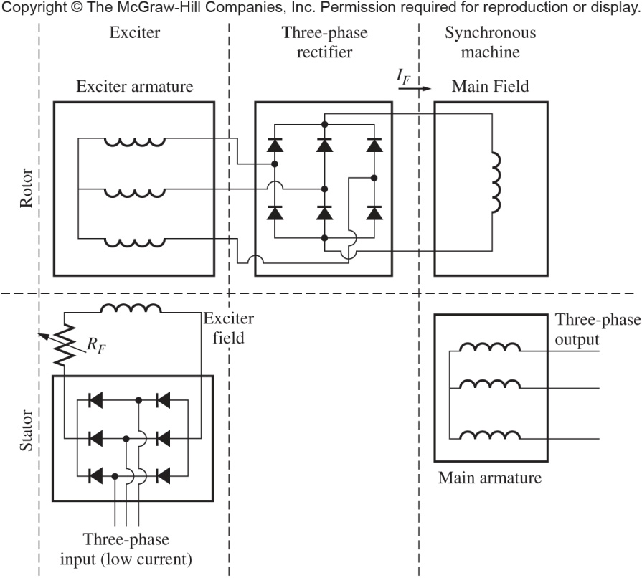
Exciter Systems for Large Generators
Brushless exciter circuit. Is a small AC generator used to create the field current. Small separate winding on stator is energized by separate source, the exciter field is produced and induces current flow in the exciter armature mounted on the rotor.
Copyright © The McGraw-Hill Companies, Inc. Permission required for reproduction or display.

Slide 4
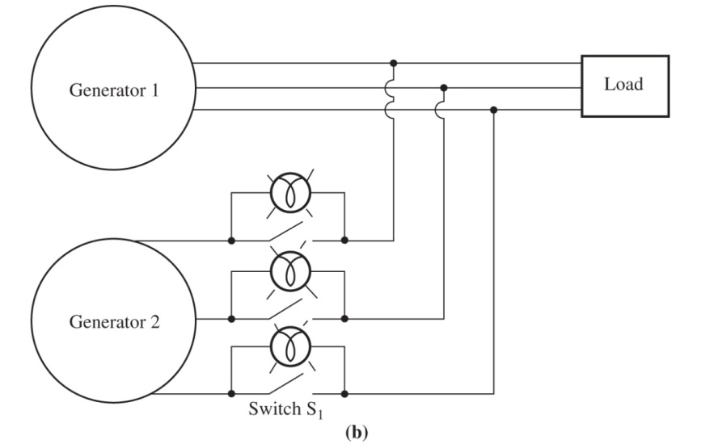

Parallel Operation of Synchronous Generators
Requirements:
Must have the same voltage magnitude.
The phase angles of the two a phases must be the same.
The generators must have the same phase sequences.
The frequency of the oncoming generator must be slightly higher than the frequency of the running generator.
Figure 4-27
The two possible phase sequences of a three phase system
The three-light-bulb method for checking phase sequence.
Copyright © The McGraw-Hill Companies, Inc. Permission required for reproduction or display.

Slide 5
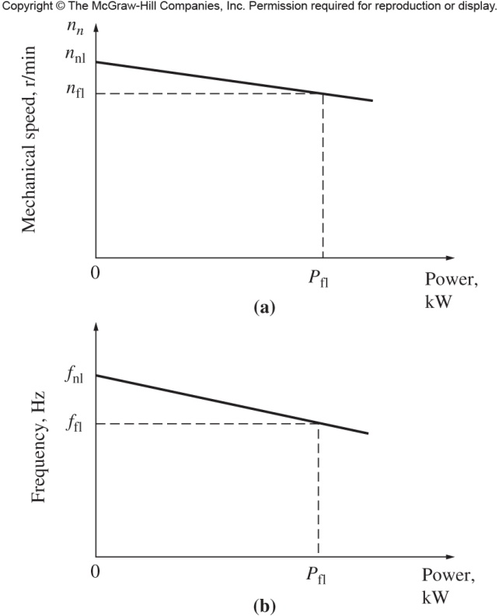
Frequency-Power Characteristics of a Synchronous Generator
(a) The speed-power curve for a typical prime mover. (b) The resulting frequency-power curve for the generator.
Copyright © The McGraw-Hill Companies, Inc. Permission required for reproduction or display.

Slide 6
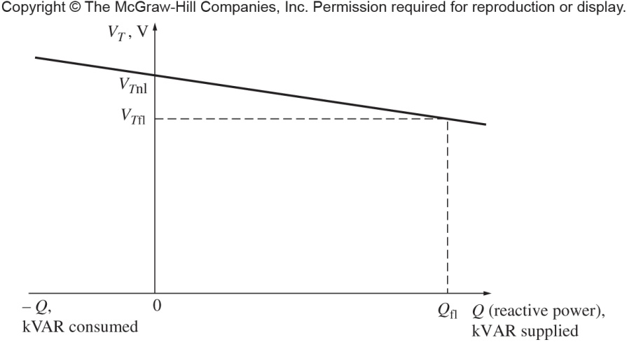
Voltage-Reactive Power Characteristics of a Synchronous Generator
Terminal voltage versus reactive power characteristics, assuming generator’s voltage regulator produces an output that is linear with changes in reactive power
Copyright © The McGraw-Hill Companies, Inc. Permission required for reproduction or display.

Slide 7
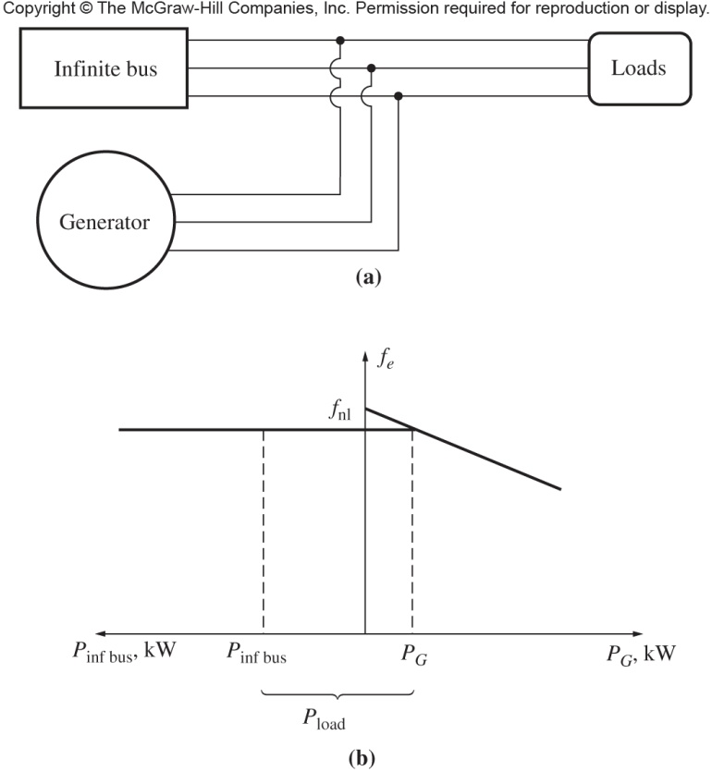
Operation of Synchronous Generators in Parallel with Large Power Systems
Since infinite bus has a constant voltage and frequency, its f-P and V-Q characteristics are horizontal lines
Figure 4-33
(a) A synchronous generator operating in parallel with an infinite bus.(b) The f-P diagram (or house diagram) for a synchronous generator in parallel with an infinite bus.
Copyright © The McGraw-Hill Companies, Inc. Permission required for reproduction or display.

Slide 8
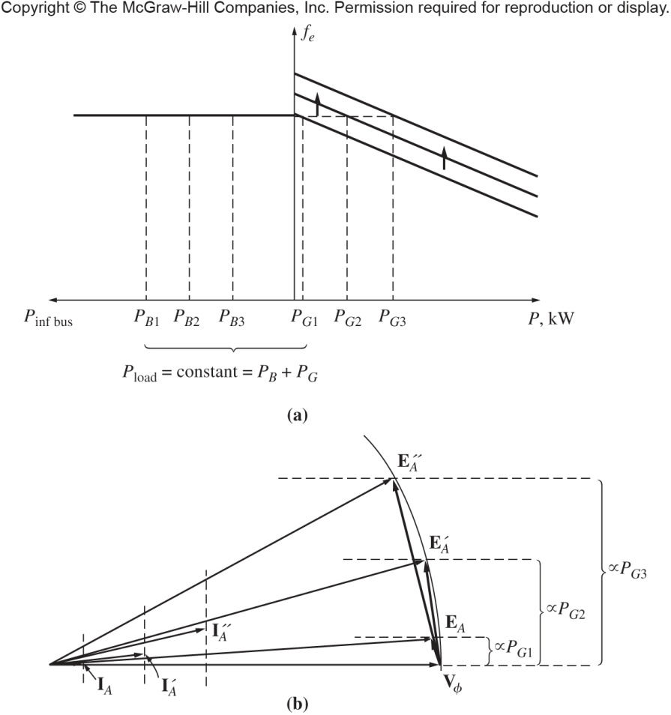
Figure 4-36
The effect of increasing the governor’s set point on at constant excitation (a) the house diagram; (b) the phasor diagram.
Copyright © The McGraw-Hill Companies, Inc. Permission required for reproduction or display.

Slide 9
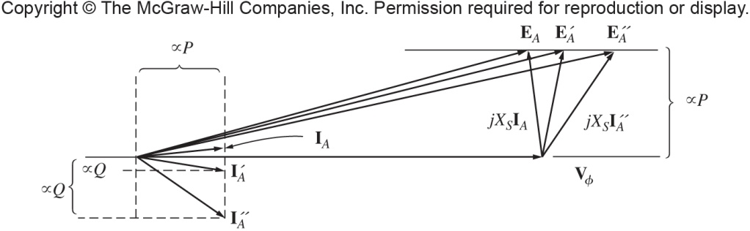
Figure 4-37
The effect of increasing the generator’s field current at constant power on the phasor diagram of the machine
Copyright © The McGraw-Hill Companies, Inc. Permission required for reproduction or display.

Slide 10
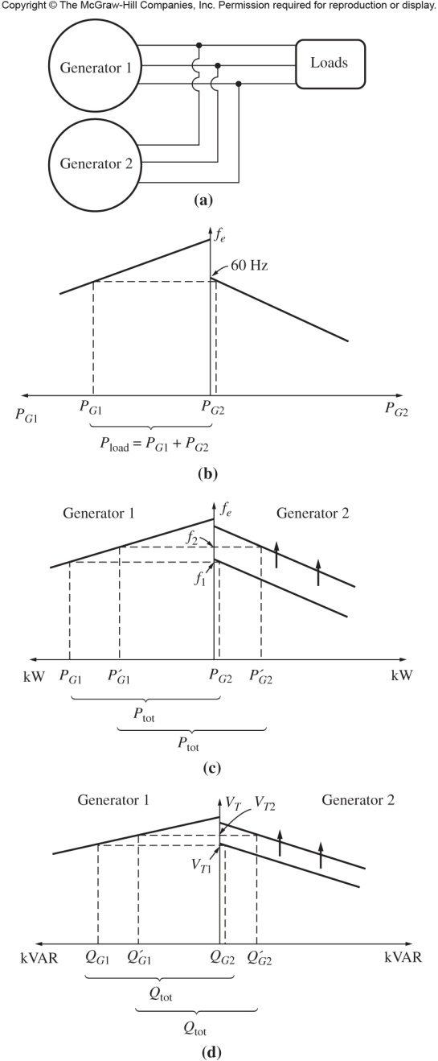
Operation of Synchronous Generators in Parallel with Other Generators of the Same Size
Figure 4-38
(a) A generator connected in parallel with another machine of the same size. (b) The corresponding house diagrams at the moment generator 2 is paralleled with the system. (c) The effect of increasing generator 2’s governor set point on the operation of the system. (d) The effect of increasing generator 2’s field current on the operation of the system
Copyright © The McGraw-Hill Companies, Inc. Permission required for reproduction or display.

Slide 11
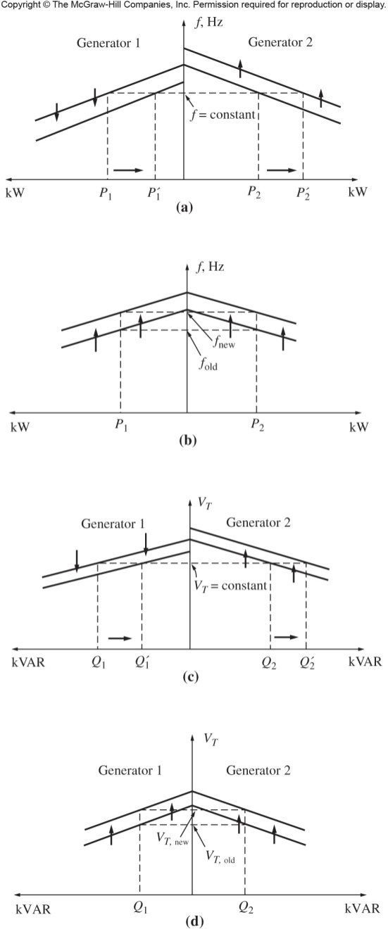
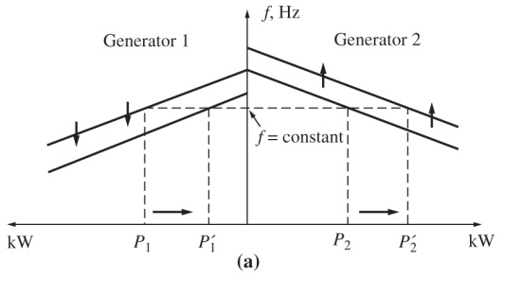
Operation of Synchronous Generators in Parallel with Other Generators of the Same Size
Figure 4-40
(a) Shifting power sharing without affecting system frequency. (b) Shifting system frequency without affecting power sharing. (c) Shifting reactive power sharing without affecting terminal voltage. (d) Shifting terminal voltage without affecting reactive power sharing.
Copyright © The McGraw-Hill Companies, Inc. Permission required for reproduction or display.

Slide 12
Synchronous Generator Ratings
Armature heating sets the limit on the armature current, independent of the power factor
For a given rated voltage, the maximum acceptable I_{A} determines the rated KVA of the generator
Copyright © The McGraw-Hill Companies, Inc. Permission required for reproduction or display.

Slide 13
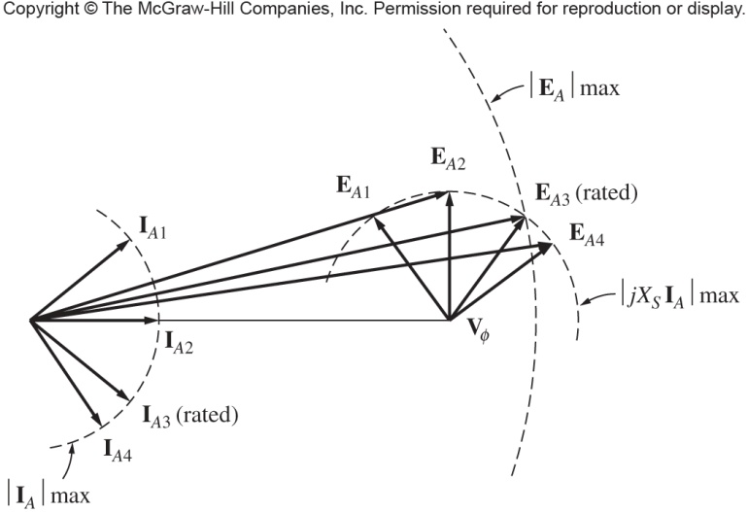
Synchronous Generator Ratings
The rotor heating sets the limit on the machine’s field current and hence sets the maximum allowable E_{A} and rated power factor
Figure 4-47
The effect of the rotor field current limit on setting the rated power factor of the generator
Copyright © The McGraw-Hill Companies, Inc. Permission required for reproduction or display.

Slide 14
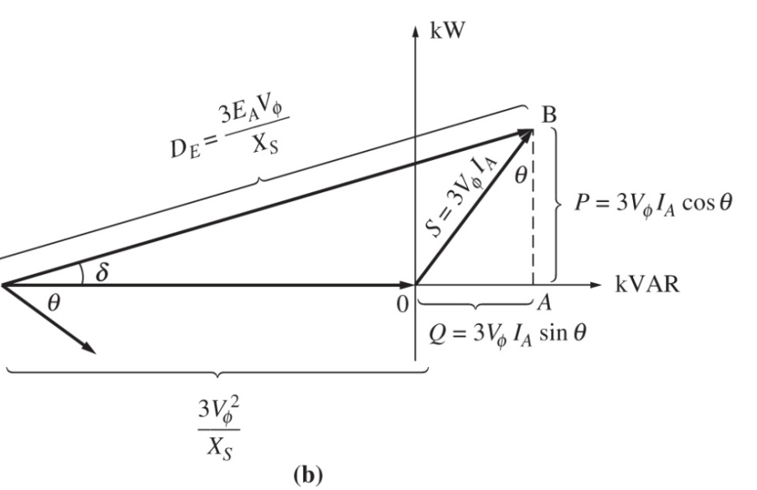

Synchronous Generator Capability Curve
Figure 4-48
Derivation of a synchronous generator capability curve. (a) The generator phasor diagram; (b) the corresponding power limits.
Copyright © The McGraw-Hill Companies, Inc. Permission required for reproduction or display.

Slide 15
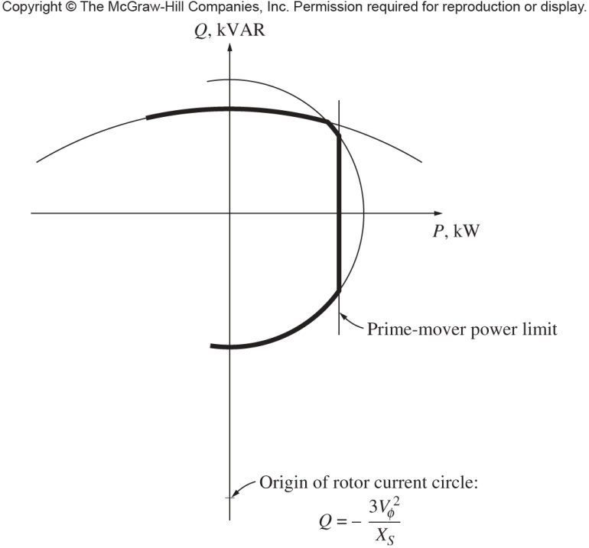
Figure 4-50
A capability diagram
Copyright © The McGraw-Hill Companies, Inc. Permission required for reproduction or display.

